Slide 1
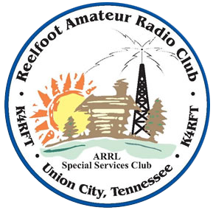
Packet Radio and aprs
Still relevant today ?
James C. Hall, MD WB4YDL
March 27, 2025

Slide 2
History of packet radio
Problem – How to connect many transmitting devices to a common communications channel (simplex)
ALOHAnet – 1970’s -Each transmitter took turns using “packets” of data
DARPA program called PRnet – 1973 – Can packet radio work with ARPAnet, the precursor to the present internet ? Success !
Hams in Canada starting using this to send ASCII data on VHF and this was approved in the USA - 1980
Notes:
These communications devices (radio, TV) would simply transmit over each other.
DARPA – Defense Advanced Research Projects Agency

Slide 3
History of packet radio (con’t)
In 1981, TCP/IP (internet protocol) for amateur radio digital communications was authorized – 44.0.0.0/8 → Network 44. This was a whole decade before the public use of this on the new internet.
TCP/IP over packet radio was popular until the internet opened to the public.
APRS (Automatic Packet Reporting System) was born at this time.
Bob Bruninga WB4APR (SK) – “Father of APRS” – 1982 – worked for US Navy using X.25 protocol to track ships at sea. He modified it for ham radio use and was called AX.25 (Amateur X.25).
GPS becomes fully operational in 1995 – so did APRS.
Notes:
RF links such as DX cluster spotting was popular on packet radio.

Slide 4

What is aprs ?
Stands for Automatic Packet Reporting System
APRS is a protocol based on good ol’ AX.25 packet radio
Designed for local tactical information over low-bandwidth radio links
“Local” is relative and can be extended by using simplex repeaters, called digipeaters.
APRS works by transmitting unconnected packets that contain a callsign, path, location, and other information.
In the United States, the single shared frequency is 144.390 MHz FM.
Notes:
“Other information” can be course, speed, and altitude, but also many other things such as weather.

Slide 5
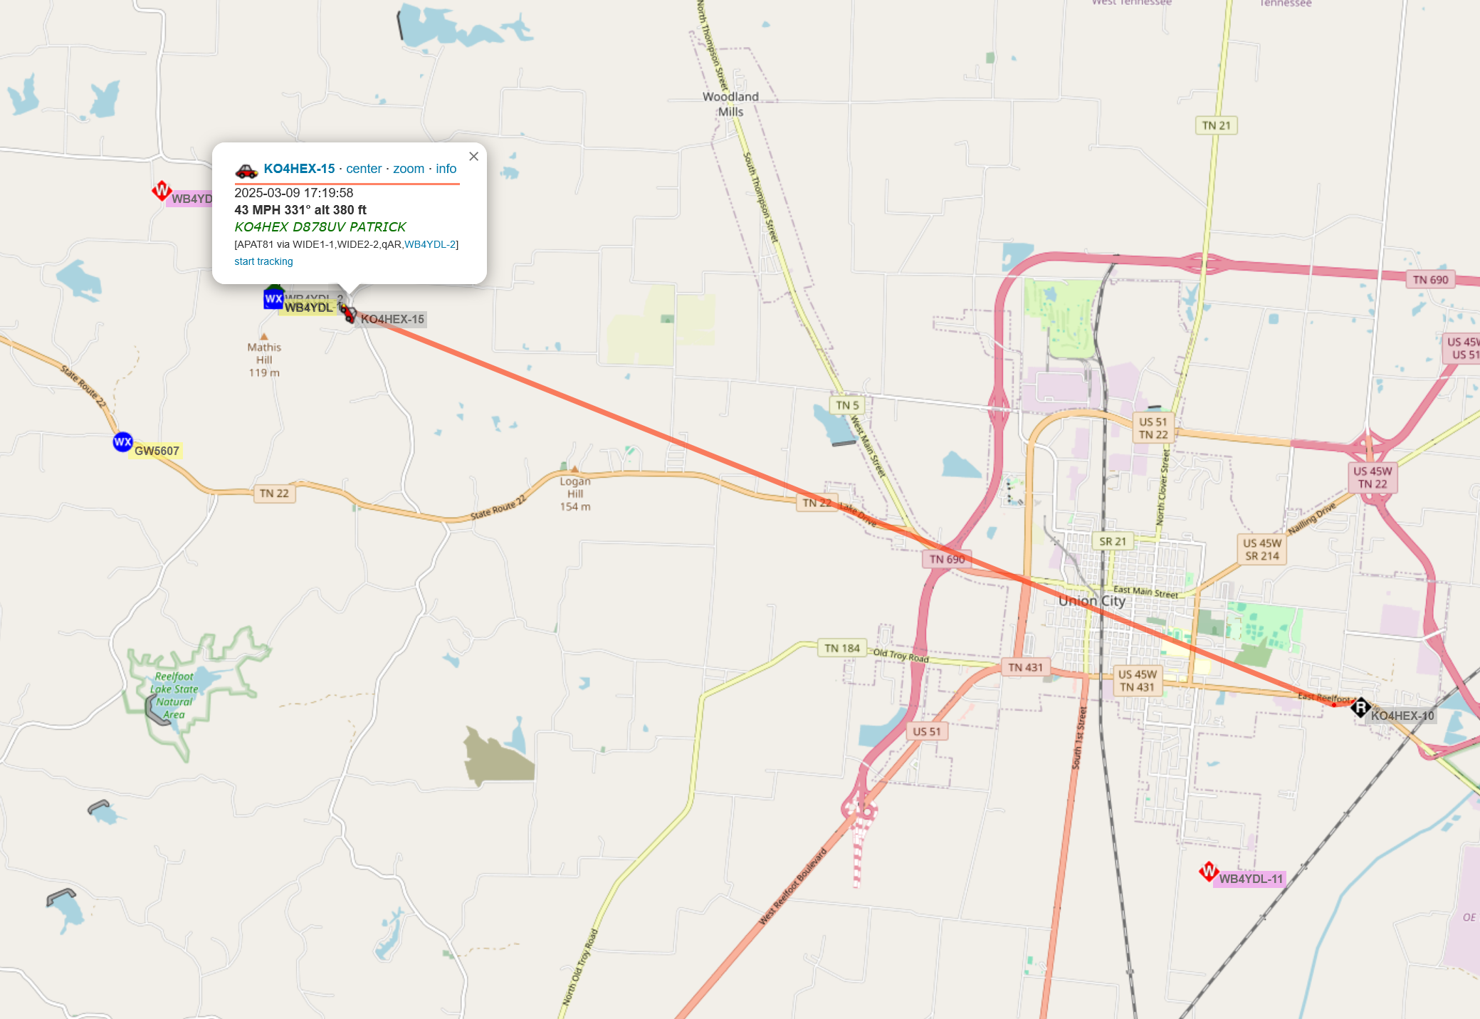
Why use APRS ?
In short, it simply doesn’t have a replacement for what it offers.
Sharing of packets of data
  Bulletins (non-location specific, general interest)
  Announcements (ham club, ham gatherings e.g. Hamfest)
  Object locations (cyclists, runners, digipeaters, balloons, MVA’s, etc.
  Texts (SMS)
  Emails (direct or Winlink)
  Radiogram traffic
Weather reporting
Telemetry data
SAR (Search and Rescue)
Direction finding
Much more … !

Slide 6
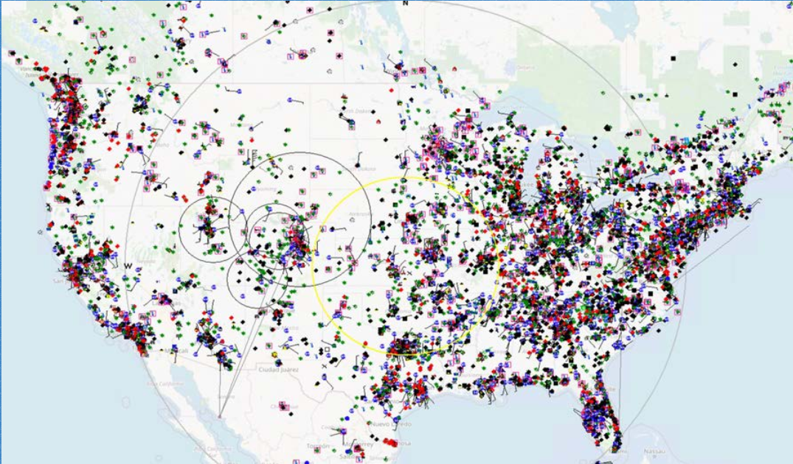
APRS is widely adopted around the world
~50,000 nodes are actively connected to the APRS-IS globally (both RF and internet-enabled devices)

Slide 7
How does aprs work ?
Messaging from station to station – can be station to group
Packet sent to iGate (Internet Gateway)
  Packet can not reliably reach the nearest iGate
  Packet repeated by in-between digipeater which is then heard by the iGate
iGate sends packet to APRS-IS and is displayed on a mapping app and to other users (non-hams too, via text, email)

Slide 8
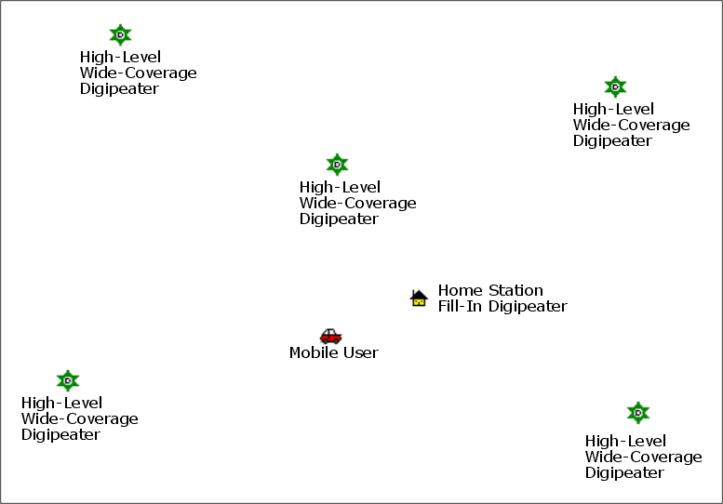
How digipeaters work

Slide 9
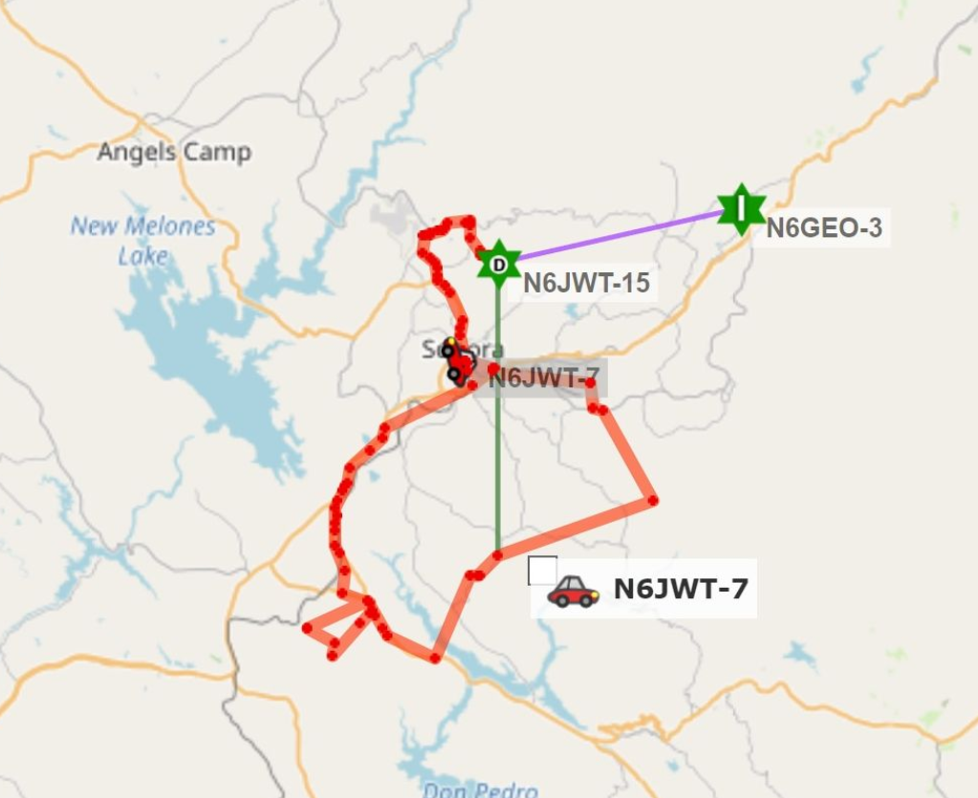
Digipeater example
N6JWT-7 is driving in wilderness area and can not hit the N6GEO-3 iGate to query WX information. N6JWT-15 is a portable digipeater setup to reach the nearest iGate.

Slide 10

Aprs-is (is = internet service)
Internet-based APRS Network
Interconnect RF-based APRS networks around the globe
Internet Gateways (iGates) bridge RF to the Internet
  RX-Only iGates
  RX/TX iGates
Ham radio nodes only !

Slide 11
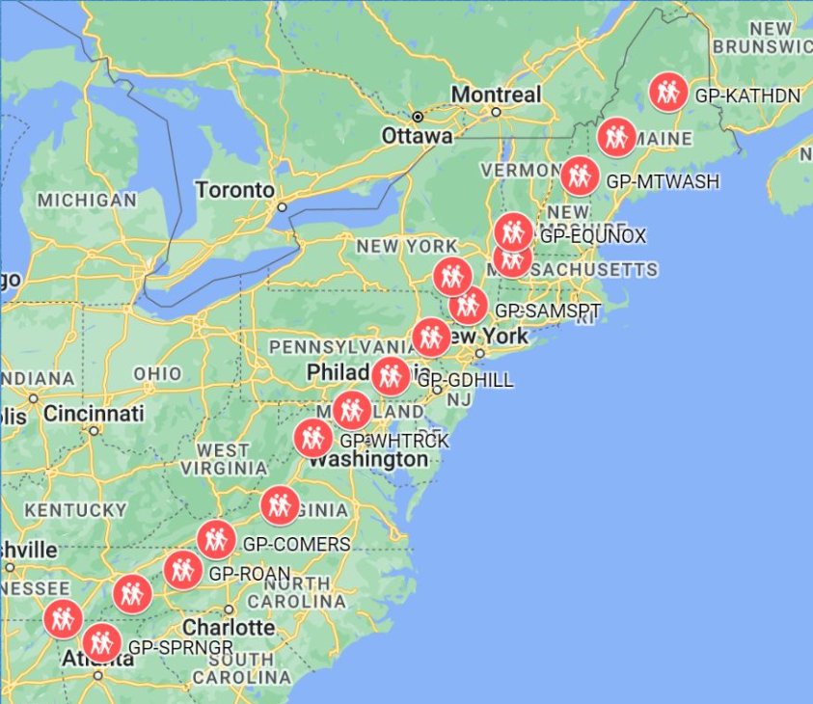
Appalachian Trail Golden Packet (ATGP)
16+ digipeaters across 2200+ miles
Proof of concept for “BEAR Net”
Originated in 2009 by Bob Bruninga WB4APR/sk
An incredibly rewarding experience !
Always the 3rd Saturday in July
Packet data is exchanged between each site with the goal of sending the “golden packet” the entire length of the trail !
https://www.atgoldenpacket.net/

Slide 12
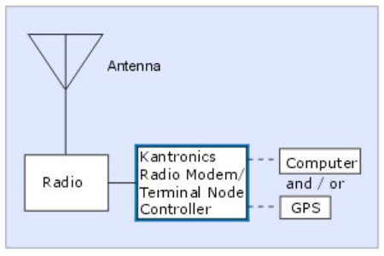
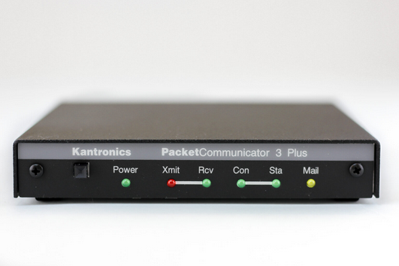
Getting started with aprs is easy
APRS is ideal for beginners and tinkerers
Don’t get bogged down with the technology – focus on what you want to do with it
Basic setup
  Radio – 2M FM; does NOT have to be APRS capable
  TNC – terminal node controller – can be hardware or software – runs the AX.25 protocol
  Data source – usually a computer, tablet or smartphone
Remember, the data itself is audio, so …

Slide 13
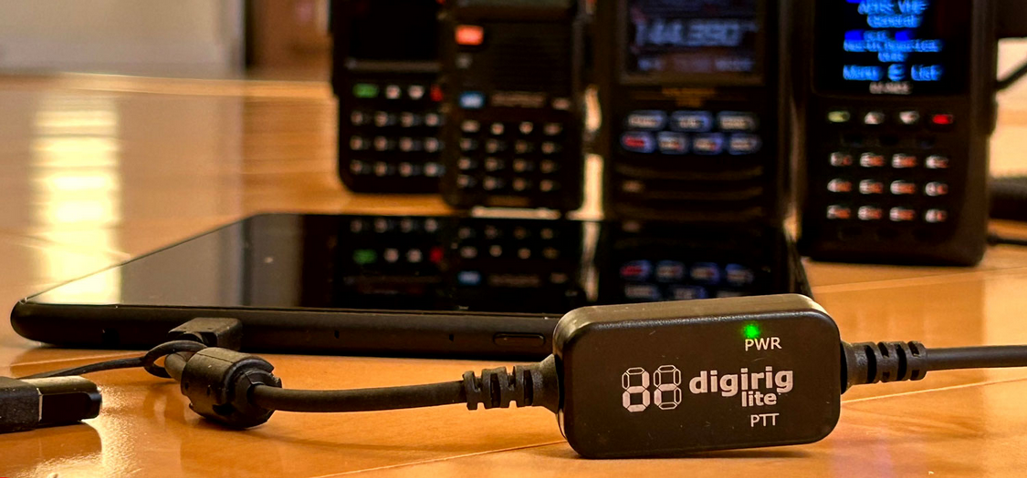
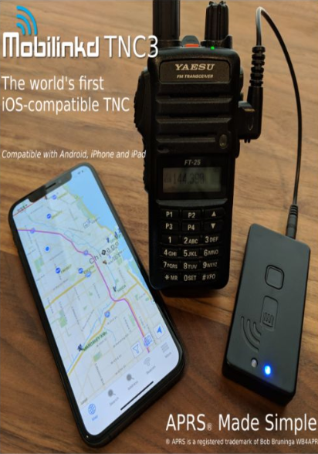
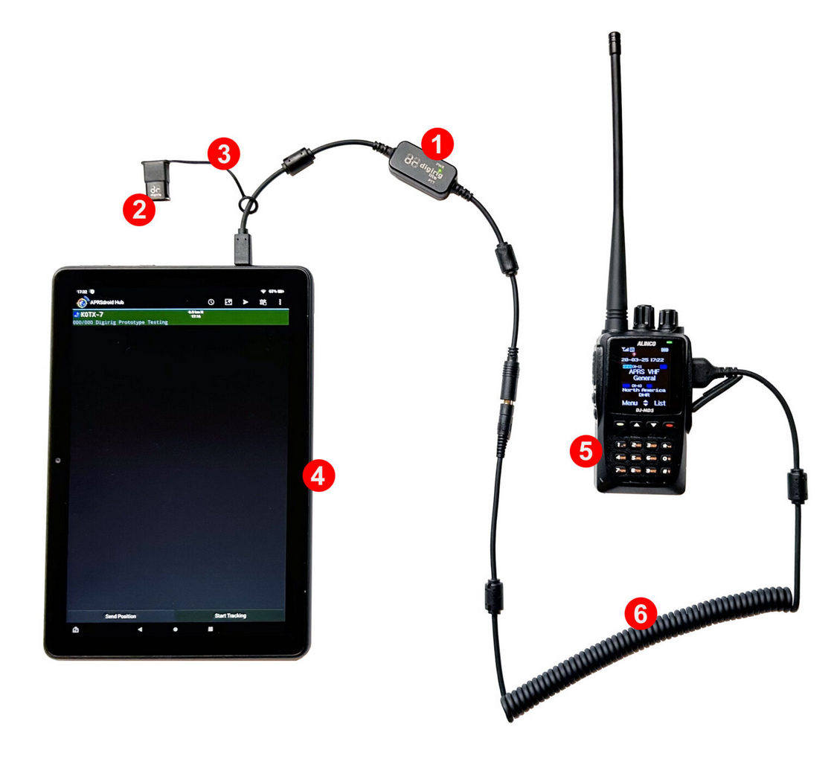
Getting started with aprs is easy (con’t)
Can use radio with audio interface
  Digirig or Digirig Lite
  BTECH APRS-K1 Audio cable
  Mobilinkd
Computer can be decommissioned Android smartphone or tablet running APRSdroid app
Can also use software TNC such as Direwolf or SmartModem on a computer such as a RaspberryPi
Lots of possibilities and no one right way
Also can use APRS-enabled radios

Slide 14

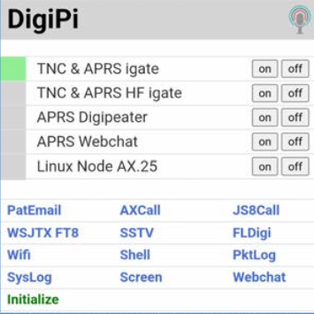
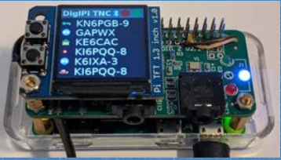
An aprs story – craig km6lyw
Avid backpacker – frequents High Sierra mountains (8000 + feet AGL)
No cell coverage. Ham radio only or bust !
Relies on APRS regularly to communicate with family members while out in the wilderness !
Led to the development of DigiPi
  https://digipi.org
  Low-cost turnkey image for the Raspberry Pi
  Based on Direwolf – a software-based TNC

Slide 15



Aprs-is – getting connected
Getting connected to APRS-IS does not require a radio
APRS Passcode (not password) is required
Internet connection
APRS-enabled application (client software)

Slide 16
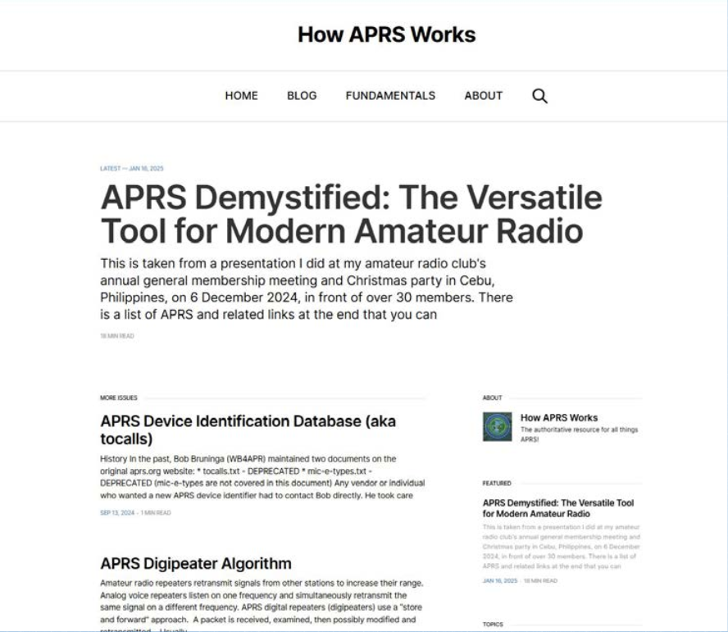
https://how.aprs.works
The NEW home for APRS enablement and information !
Current information
Authored by APRS-savvy hams around the world !
You can contribute too !

Slide 17
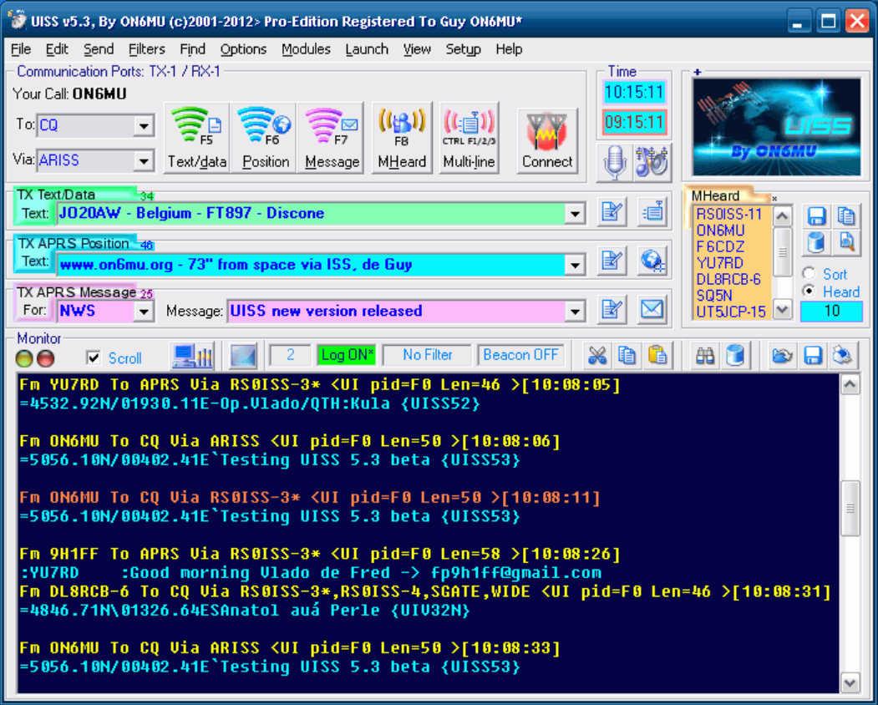
Other fun things to do with aprs
Work others using the ISS digipeater
Frequency is 145.825 MHz
Use a satellite tracking program to predict the next overhead pass
UISS application by Guy ON6MU

Slide 18
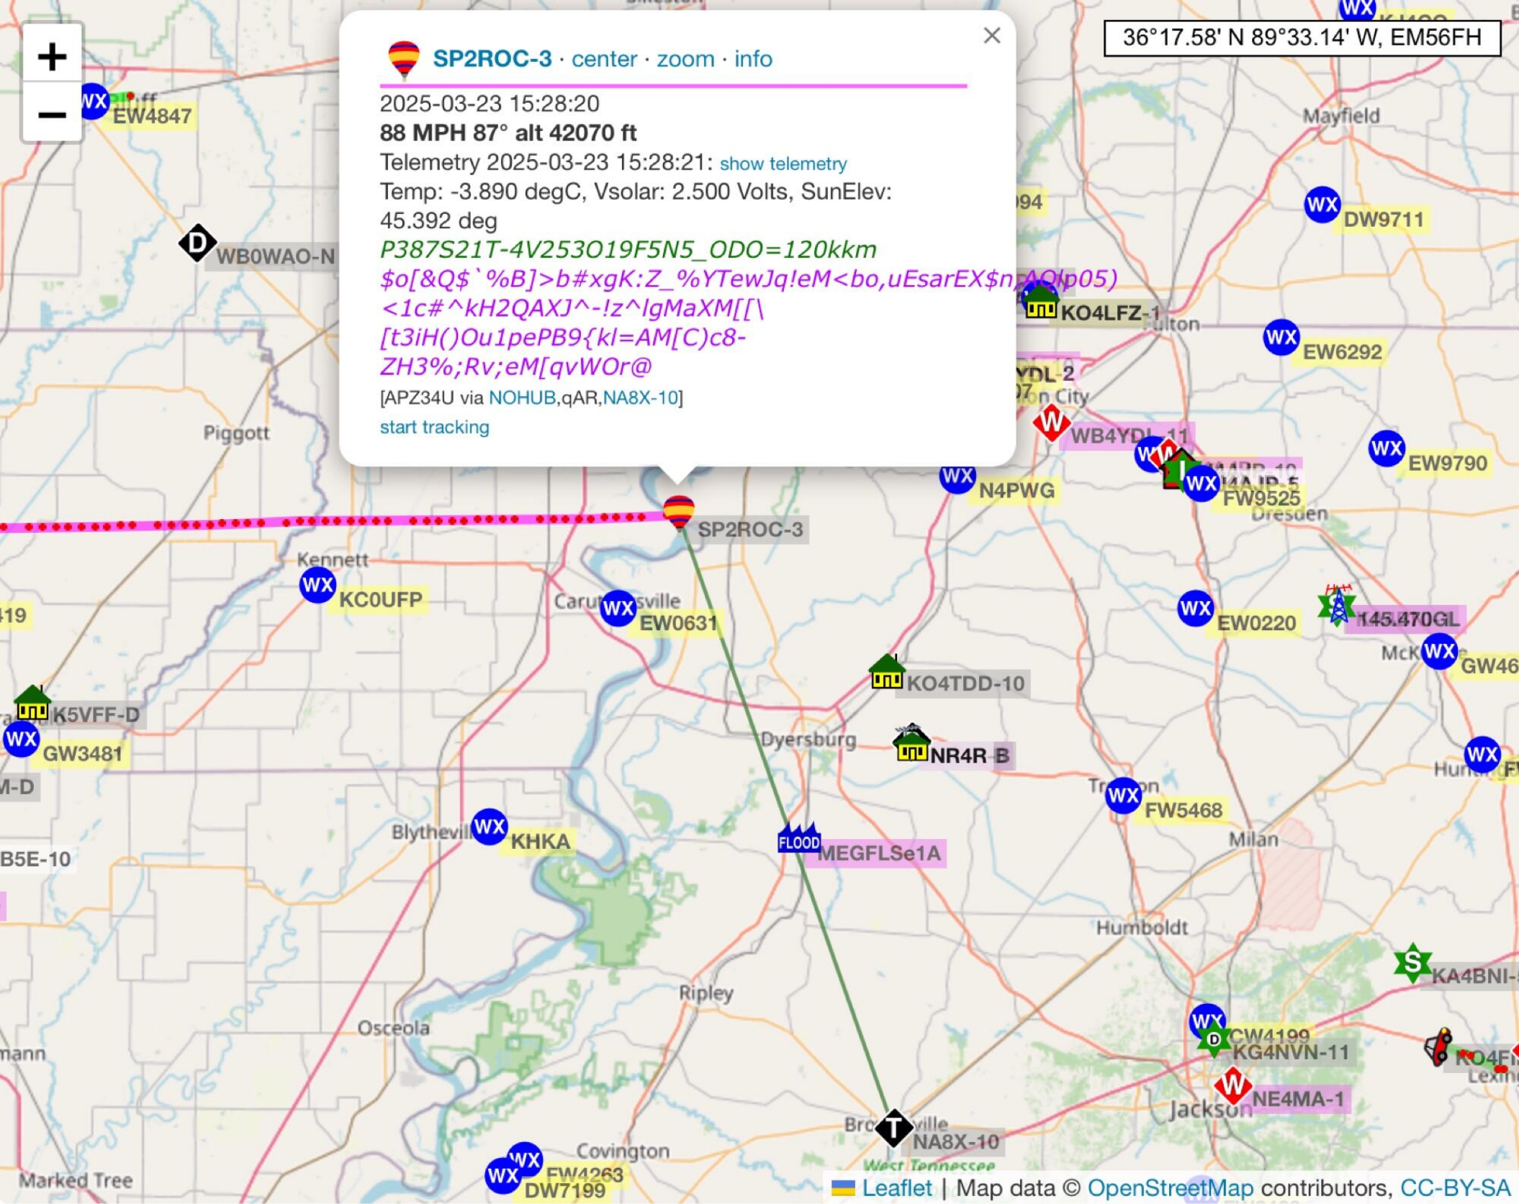
High altitude balloons
Ham balloons often circle the world
Supporting scientific experiments, weather research and student projects !
APRS provides telemetry and sensor data …
Temperature, air pressure, humidity, radiation levels
Burst altitude (Pop !) and decent path (recovery)

Slide 19

Bots, bots, bots !
APRS-connected systems to perform specific tasks
  ANSRVR – group messaging
  APSPOT – self spotting
  CQSRVR – similar to ANSRVR
  DAGA – SOTA spotting
  MPAD – WX/METAR, OSM (Open Street Map), sat passes, nearest repeater, even fortune teller !
WXBOT – weather forecast
REPEAT – nearest repeater information
WTSAPP – APRS to WhatsApp gateway
SMS – APRS to SMS texting
NTSGTE – send Radiogram to National Traffic System (NTS)
WHO-IS – callsign lookup
MAIL – APRS mail

Slide 20
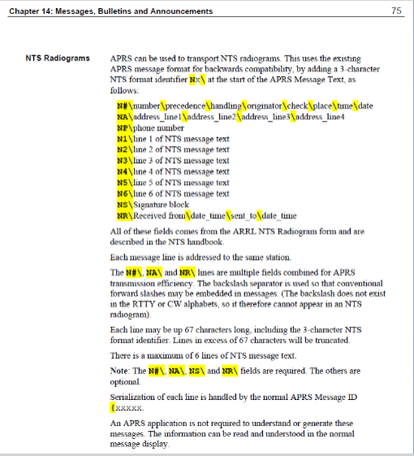
Sending Radiogram via aprs
Send message to NTSGTE
In body of message, put QTC 1
Send this and bot will respond as ready to receive
You send one line at a time beginning with preamble
After sending signature, bot will respond as message # sent
If there’s an error say with check number, the bot will ask you to correct it

Slide 21
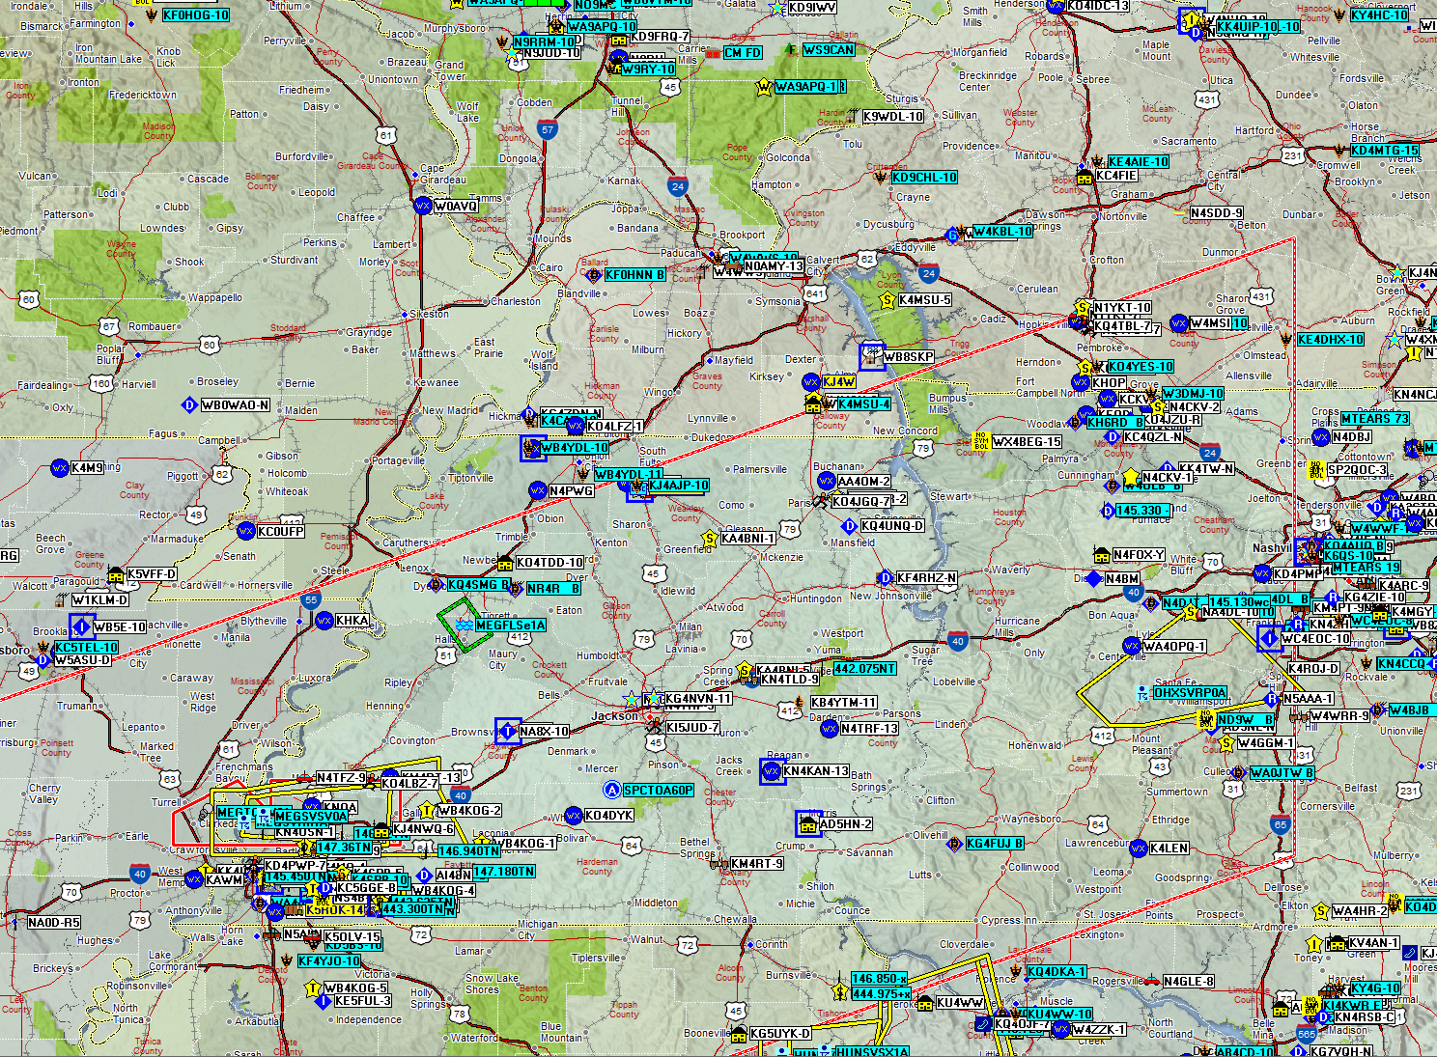
Questions ?

